Slide 1
OLIGOPOLY
An Oligopoly is a market dominated by a small number of firms.
What is small? One way to measure this is the % of sales accounted by the top four firms. = "4-firm concentration ratio"
Can use public market share info to compute these
  Effective Monopoly = Single firm concentration ratio>90%
  Effectively Competitive = 4-firm concentration ratio<40%
  Loose Oligopoly = 60%>4-firm concentration ratio>40%
  Tight Oligopoly = 4-firm concentration ratio>60%
75% of all production in USA is competitive.
2-3% of production is effective monopoly.
10% is a tight oligopoly.
12% loose oligopoly.

Slide 2
Example US Brewing Industry
1998 1997
Anheuser-Busch Cos. 46.6% 45.6%
Miller Brewing Co. 21.1 21.8
Adolph Coors Co. 10.5 10.3
Stroh Brewery Co. 6.7 7.9
S&P (Pabst Brewing Co.) 2.0 2.4
Heineken 1.8 1.7
Interbrew (Labatt USA) 1.6 1.4
Gambrinus Co. 1.4 1.0
Canandaigua Wine Co. 1.3 1.0
Total top 10 93.7 93.9
Total market in barrels 202.0 200.3

Slide 3
The 1998 Concentration Ratios are:
1 firm 46.6%
2 firm 67.7% = 46.6+21.1
3 firm 78.2% = 67.7+10.5
4 firm 84.9% = 78.2 + 6.7
5 firm 86.9% = 84.9 + 2.0
6 firm 88.7% = 86.9 + 1.8
7 firm 90.3% = 88.7 + 1.6
Limitations of Concentration Ratios:
Why only concentrate on a subset of firms?

Slide 4
Herfindahl – Hirschman Index (HHI)
Take the sum of the squares of all firms market shares:
Example: Beer 1997
HHI = (45.6)²+ (21.8)²+(10.3)²+(7.9)²+(2.4)²+(1.7)²+(1.4)²
+(1)²+(1)²
= 2739.36+475.24+106.09+62.41+5.76+2.89+1.96+2
= 2735.71

Slide 5
Properties of HHI
In a pure monopoly HHI = 10,000
In perfect competition HHI = 0
In a market with n firms with equal shares of 100/n%.
HHI = (100/n)²+…+(100/n)²
= n(100/n)² = 10,000/n

Slide 6
Examples
Industry with:
2 equal firms HHI = 5,000
3 equal firms HHI = 3,333 1/3
4 equal firms HHI = 2500
5 equal firms HHI = 2000 etc
(1) Counts market share of all firms not only the biggest.
(2) The more unequal the shares the greater the index.
(3) More firms the lower the index.

Slide 7
Importance
HHI index used by Justice Department's in Merger Guidelines
HHI <1000 Unconcentrated
1000<HHI <1500 Moderately Concentrated
HHI >1500 Concentrated
Mergers are allowed if they do not increase the HHI by too much.

Slide 8
General Problems with these Measures
1 Sometimes the description of the industry is too loose and it should be more closely related to products:
Pharmaceuticals: Merck or Pfizer & Warner Lambert have 6-7% shares.
(Not concentrated?) Treatments
2 Geography (e.g. Newspapers & Cement) Competition is not national.
3 There may be competition from dissimilar production processes (E.g. glass/plastic/paper containers )
4 What about imports? 13% GDP imports so many industries are more competitive because of US market shares.

Slide 9
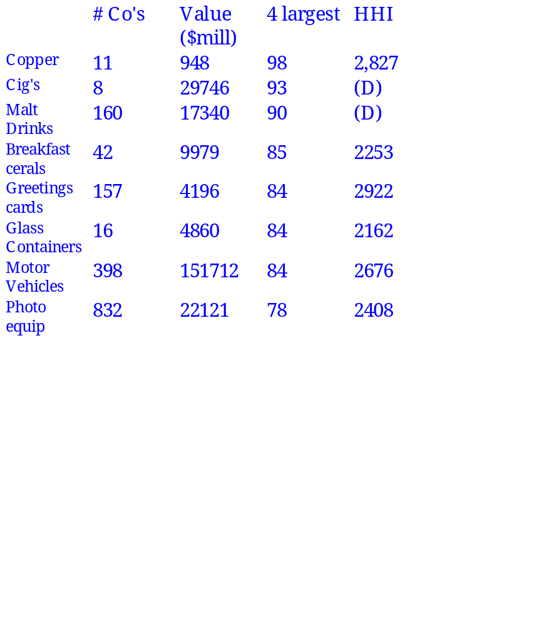
Concentration Ratios In Manufacturing 1992 (Source US Census of Manufactures)

Slide 10
Concentration Ratios In Manufacturing 1992 (Source US Census of Manufactures)
# Co's
Value
4 largest
HHI
($mill)
Copper
11
948
98
2,827
Cig's
8
29746
93
(D)
Malt
160
17340
90
(D)
Drinks
Breakfast
42
9979
85
2253
cerals
Greetings
157
4196
84
2922
cards
Glass
16
4860
84
2162
Containers
Motor
398
151712
84
2676
Vehicles
Photo
832
22121
78
2408
equip

Slide 11
Concentration and Prices
Increased concentration in general is associated with higher prices and higher profits.
  Perfect comp (Low price low profit)
  Monopoly (High price high profit)
  Less firms => Less competition more opportunities for collusion, competition in other dimensions.
Note: There are many different dimensions over which firms in oligopolies compete, not just prices!

Slide 12
Revision: Barriers to Entry
For an oligopoly to persist there must exist barriers to entry. What are Barriers to entry?
  Economies of Scale (cable TV)
  Large Set up Costs (Oil Refining)
  Quality advantages (soft drinks)
  Differentiation of Products (Breakfast cereal)
  Control of Resources (OPEC)
  Patents, Trademarks (Glaxo – Zantac)
  Strategic Barriers (Firms may take actions to deter entry Titanium Dioxide Industry)

Slide 13
Oligopoly and Quantity Competition
Oligopolist competes in many dimensions. First we will study quantity competition.
Cournot

Slide 14
Cournot's Model
2 firms choose output simultaneously; both firms output affects price.
The demand curve is P = 30 – Q
MC is constant at 6.
Firms produce exactly the same good, i.e. good is homogeneous.
Total output is the sum of the firms' individual outputs.
P = 30 – (Q₁+Q₂)

Slide 15
Best response functions
A best response function for a player gives the optimal choice of action for that player as a function of the actions of the other players.
The best response function for firm 1 gives firm 1's optimal output as a function of what is expects firm 2's output to be, and vice versa. If player 1 expects player 2 to choose Q₂, what should Q₁ be?

Slide 16
Calculating a Best Response
Revenue = P Q₁ = [30-Q₁-Q₂]Q₁
MR = dR/dQ₁ = 30-2Q₁-Q₂
MC = 6 (From above)
MR =MC or 30-2Q₁-Q₂ =6
Q₁ = 12 – Q₂/2.
This tells us firm 1's best output as a function of firm 2's output.
What firm A does depends on what it thinks firm B does.

Slide 17
In pictures:
The monopoly output is where Q₂=0
Q₂
Q₁ = 12 – 0.5 Q₂
Q₁

Slide 18
Both firm 1 and firm 2 have optimal responses let us put them together. Firm 2's best response function is
Q₂ = 12 – Q₁/2.
Q₂
Q₂ = 12-0.5Q₁
Q₁

Slide 19
They only cross at an output of 8 each.
A situation where each player is making a best response to the action of the other player (or more generally other players) is a Nash Equilibrium.
Firm's actions are optimal given their beliefs about the choices of others.
Why should it be the case that the players magically happen to chose mutually consistent best responses?

Slide 20
(1) The two firms have both played games like this often enough before, that they have a pretty good understanding. Therefore the only thing which could stand up is a Nash equilibrium.
(2) The firms don't trust each other, so they only make agreements that they will each have an incentive to keep. But, this again is Nash equilibrium.
(3) The two firms go back and forth, each announcing their output plans, until each firm is happy its the output.
The useful graph to look at:

Slide 21
Suppose firm 1 has initial output as below what does 2 do?
Q₂
1’s optimal responses
2’s optimal responses
Q₁

Slide 22
2 Responds with a low output what does 1 do?
Q₂
1’s optimal responses
2’s optimal responses
Q₁

Slide 23
1 responds by reducing its output what does 2 do?
Q₂
1’s optimal responses
2’s optimal responses
Q₁

Slide 24
Slowly they converge to the intersection.
Q₂
1’s optimal responses
2’s optimal responses
Q₁

Slide 25
To find the Cournot equilibrium.
(1) Take the 2 reaction functions and solve them simultaneously.
Q₁ = 12 – Q₂/2
Q₂ = 12 – Q₁/2.
Implies
Q₁ = 12 –(12 – Q₁/2)/2.
Q₁ = 8 and Q₂ = 8
The market price = P = 30 –(8+8) = 14.
Each firm has profits of 64 = 8(P-MC)
Industry profits are $128.
This pair of outputs is the only one at which both firms are using best responses, i.e., the unique Nash equilibrium.

Slide 26
Under Perfect Competition
P = MC, so 30 - Q = 6,
Q = 24, P = 6.
Industry profits = 0.
Under pure monopoly
MR = 30 - 2Q,
MR = MC gives 30 - 2Q = 6, or Q = 12,
P = 18,
Profit = 12(18-6) = 144
Qmon < QDuop < Qcomp
Pmon>PDuop > Pcomp
mon > Duop > comp

Slide 27
TSmon < TSDuop < Tscomp
TS=Total Surplus = Consumer Surplus + Producer Surplus
Total surplus is just the area above MC and below the demand curve up to the output actually produced.
Total surplus is ranked in the same direction as quantity (since at all relevant quantities, demand curve is at least as high as MC).
Cournot oligopoly with one firm is monopoly.
Cournot oligopoly with two firms, results in higher total output (but till less than the competitive level), lower industry profits, and more total surplus than monopoly.
There is a sense in which monopoly and competition are extreme cases of oligopoly with different numbers of firms.

Slide 28
A Diagram that says it all
Oligopoly will drive firms to prices are low quantities high
Q₂
1’s reactions
2.s reactions
Q₁

Slide 29
A Diagram that says it all 2
A monopoly is at the point prices are higher
Q₂
1’s reactions
2.s reactions
Q₁

Slide 30
A Diagram that says it all 3
This line is the contract curve where firms cooperate to lower output raise prices and increase profit (acting as a joint monopoly).
Q₂
1’s reactions
2.s reactions
Q₁

Slide 31
A Diagram that says it all 4
Under perfect competition the firms are at with higher output and zero profit
Q₂
1’s reactions
2.s reactions
Q₁

Slide 32
Summary
Monopoly Output is lower than the Cournot Output.
If the firms form a cartel they will negotiate an agreement on the Contract curve.
Contract curve is where total output is equal to the monopoly output.
Perfect Competition is off the reaction curves at higher output and lower prices (each firm ignores the effect it has on the other!)

Slide 33
Stackelberg Equilibrium: One Firm Moves First (First Mover Advantage)
Suppose that the player Microsoft/Fox gets to move first in the ratings game.
Fox
HDTV
Standard
Network
Network
HDTV
Standard
HDTV
Standard
(100,50)
(0,0)
(30,20)
(60,90)

Slide 34
This gives Fox a strategic advantage.
Fox is committed to HDTV, and then the best that the networks can do is to follow suit.
Your move to day leads the competition to
Sometimes moving first can be a burden…
If you are the first ice cream seller to locate, then the second mover can do at least as well as you can.
Penguins on the edge of the sea.

Slide 35
Threats and Commitments
The networks could say to Fox…
"if you adopt HDTV we will adopt
standard technology anyway".
Is this threat credible?
Threats may not be carried out – the same problem arises with promises…

Slide 36
Example:
Multinational firm must decide to invest in a developing country but the country can expropriate the investment.
The purpose of bankruptcy & contract law is to avoid this problem.
(50,50)
DC
MNF
Expropriate
(-20,80)
Do not invest
(0,0)

Slide 37
Example: Entry Deterrence
An incumbent would prefer the entrant not to enter but cannot back up its threat to fight entry.
• Suppose the incumbent builds a large plant which is loss making unless it has a large share of the market. This reduces the incumbent's payoff to sharing the market to 20. Then what does the incumbent want to do?
(40,40)
Incumbent
Entrant
Fight entry
(-20,30)
Do not enter market
(0,100)

Slide 38
Back to Oligopoly
• Suppose that the firms do not move at the same time and firm 1 moves first and then firm 2 moves.
• From above Firm 2 will choose to be on its reaction function.
• Firm 1 will choose to expand its output and force firm 2 to produce less. Presents firm 2 with a fait accompli.

Slide 39
Again recall the Dupont Titanium Dioxide Case!
Titanium Dioxide is a whitener used in paints, paper and plastics
1972 there were 7 main manufacturers
Dupont 34%
National Lead 23%
American Cyanamid 14%
SCM 10%
Gulf & Western 9%
Kerr McGee 6%
Sherwin Williams 4%
3. The mode of production was changing.
4. Dupont massively invested in capacity $400m increased capacity to get 64% by 1985.
5. Lower costs of production deters others from entering.

Slide 40
Oligopoly: Price Competition
The Kinked Demand Curve Model
In oligopoly, the actions of one firm are dependent on what it think others will do and how it thinks other will react.
This is a model of stable prices in oligopolies – large numbers of oligopolies experience this.
Not Price Wars

Slide 41
Why is the demand curve kinked?
The firm sets the price P*.
If it sets a higher price P'>P* it believes its rivals will not change their prices, so sales fall rapidly for P'>P* as its customers switch suppliers.
If it sets a lower price P''<P* it believes its rivals will match the price change, by cutting their prices.
There is not a big change in demand when it cuts price.
Effect on MR
MR is flat for P'>P*.
At P* MR jumps down.
MR is steep for P''<P*.

Slide 42
Profit Maximization
The jump down in MR means that MC intersects MR at the jump and P* is optimal.
Even if costs change to MC' the firm does not change prices.
P*
MC'
Demand
MC
MR

Slide 43
Comments
1) This is a model of "tacit collusion".
2) Firm's fears of price wars are probably justified – see later.
3) What determines what P* is?
(May be a commonly accepted markup of costs.)
4) Evidence seems to be that price increases are copied as quickly as price cuts.
5) May need a price leader for this model to work (usually the largest firm, but can change over time, problem is price leaders are not always followed).

Slide 44
Extreme Price Competition:
Bertrand Competition
Let us make three strong assumptions
(1) The lower-priced firm always claims the entire market. (Firms produce identical products.)
(2) All competition is in prices.
(3) If the firms set equal prices they will share the market.

Slide 45
Ferry Company Example
There are two ferry companies (airlines) on the same route competing only on price.
The marginal cost per customer is $30 for both companies.
There are 1000 customers who are willing to pay up to $50 to make the crossing.
Company 1 charges a price P₁ and company 2 charges P₂. How should they choose these prices?

Slide 46
Analysis
Suppose, they set equal prices of $50 and share the market. Profit of each firm is 500(50-30) = 10,000.
Then, firm 1 can cut its price to 49 attract all the customers and make profit 19,000 = 1000(49-30).
In response firm 2 can undercut firm 1 by asking the price 48 and attracting the whole market.
This process continues until both firms are charging the price 30 and making zero profit.

Slide 47
Firm 1's Profit
Firm 1's Profit
Firm 1's Price
MC
P₂

Slide 48
Comments
1) Pure price competition can drive oligopoly close to perfect competition!
2) Notice that price competition does not expand the market in this case. Often lower prices generates more customers. Will the expansion of the market affect the above predictions?
3) This form of price competition is very much like an auction where the sellers are competing for customers.
4) If they are producing identical goods shouldn't the firms be competing on quantity not price?

Slide 49
Extension 1: Bertrand Competition with Capacity Constraints
Suppose now the ferries cannot hold all 1000 customers, but can only hold 800 customers.
A firm's profit doesn't jump down to zero when it is under cut.
Firm 1's Profit
800(P₁-30)
200(P₁-30)
MC
P₂
50

Slide 50
When firm 1 is the lowest priced firm and its price=35, the profit it makes is 800(35-30)=4000. Firm 2 does not want to undercut its rival but instead prefers to charge P=50 for the remaining 200 travelers also making the profit 200(50-30)=4000.
If firm 2 is charging $50 then firm 1 will prefer to set price $49.
Firm 2 will then want to undercut this price and charge $48.
Prices go around in circles?

Slide 51
Extension 2: Price Guarantees
You often see firms advertising along the lines "If you can find this product for less anywhere else we will refund twice the difference".
Is this competitive or collusive?
The answer to this depends on whether all consumers can see all the prices – or not.
Because the question firms must answer is…
"given the prices of my competitors what price do I want to set if I have a price guarantee?"

Slide 52
Case 1: Consumers can see all prices at all times.
Firm 1's Profit
800[P₁-2(P₁–P₂)-30]
MC
P₂
50

Slide 53
There is now a cost to undercutting, because all customers go to your rival and claim an even lower price. Profit jumps down to zero.
If you raise your prices, you are in effect offering a lower price than your rival. So demand jumps up.
Firms are going to respond to this by raising prices until both firms are setting the price of $50.
This is collusive – firms are promising their rivals not to undercut them on price. (It is very expensive to undercut your rival on price.)

Slide 54
Case 2: Consumers cannot see all prices at all times.
You don't lose all of your customers by charging a lower price. You just lose some of them! Still collude!
Firm 1's Profit
MC
P₂
50

Slide 55
Price Competition with differentiated Products
Goods are not usually identical, usually demand does not jump to zero for the lowest price firm.
An Example:
Firm 1 : Q₁ = 12 – 2P₁ + P₂
Firm 2 : Q₂ = 12 + P₁ – 2P₂
The firm's demand is increasing in the other's price (Substitutes).
Costs = 20 and are fixed.

Slide 56
Firm 1's profit = P₁Q₁ – Cost
= 12 P₁ – 2P₁² + P₁P₂ – 20
The slope of firm 1's profit as price changes is
12 – 4P₁ + P₂
To maximize profit 0 = 12 – 4P₁ + P₂ and this gives
4P₁ = 12 + P₂
P₁ = 3 + 0.25P₂
A similar calculation for firm 2 makes
P₂ = 3 + 0.25P₁

Slide 57
Why do optimal prices go up when your rivals does but quantities do the reverse?
The Firms Reaction Curves or Optimal Responses
The Nash equilibrium is at (P₁,P₂)= (4,4). Can we tell the same stories about firms reaching Nash equilibrium?
P₂
P₂ = 3 + 0.25P₁
P₁ = 3 + 0.25P₂
P₁

Slide 58
Finding the Nash equilibrium
(1) Put firm 2's optimal response into firm 1's reaction function
P₁ = 3 + 0.25P₂
= 3 + 0.25[3 + 0.25P₁]
(2) Rearrange for P₁
P₁ = 3 + (3/4)+ (1/16)P₁
(15/16)P₁ = 15/4
P₁ = 16/4 = 4.

Slide 59
Finding the Collusive outcome.
Both firms will set the same price.
Profit = 12P₁-2P₁²+P₁P₂
= 12P₁-2P₁²+P₁P₁
= 12P₁-P₁²
Slope =0
12 – 2P₁=0 or P₁=$6
The firms should coordinate their prices to maximize total profit.
Each firm should recognize that they need to raise prices because of the effect each firm's price has on the other's profits.

Slide 60

The Price Leadership Model
If firm 1 is a price leader it knows that firm 2 will set the price P₂=3+(1/4)P₁. So what price should firm 2 set.
It should choose a price to maximize
12 P₁ – 2P₁² + P₁P₂ – 20
= 12 P₁ – 2P₁² + P₁[3+(1/4)P₁] – 20
= 15 P₁ – 1.75P₁² – 20
The slope of this profit function is
15 – 3.5 P₁
To maximize profit set 15 – 3.5 P₁=0, thus the price leader sets
P₁ = 15/3.5 = 4

Slide 61

The price leader chooses to set a higher price. The follower sets the price P₂=3+(1/4)P₁, so
P₂ = 4
Who is doing well here?
Is there a first movers advantage or disadvantage?
Firm 2 has greater demand and marginally lower price therefore it is doing better.
Price Competition and the Prisoners' Dilemma

Slide 62
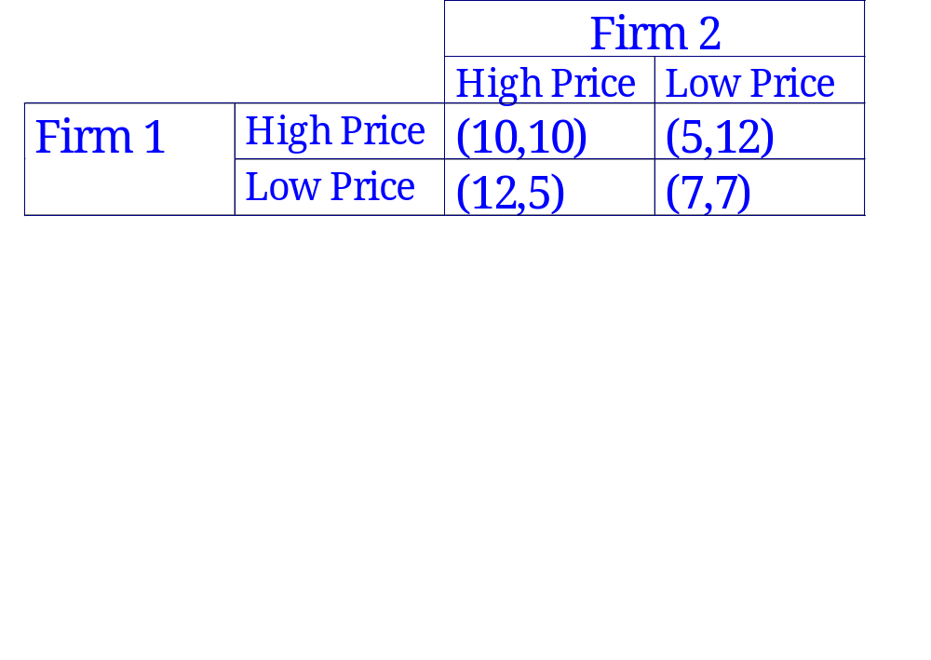
Suppose there are two firms and the profits they make are described by the following game.
Both firms would like to charge high prices.
The equilibrium is low prices.
(Each firm has a temptation to set low prices when the other sets a high price.)
Why is this the Prisoners' Dilemma?

Slide 63
Similar examples
(1) Talking at parties.
(2) Dropping litter.
(3) Fishing.
Resolutions
(1) Social Norms – Voting.
(2) Repeated play. (Opec)

